Slide 1
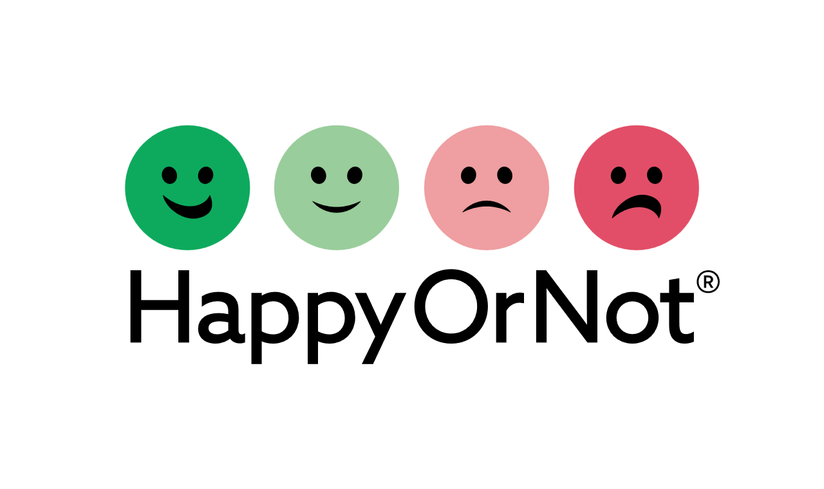
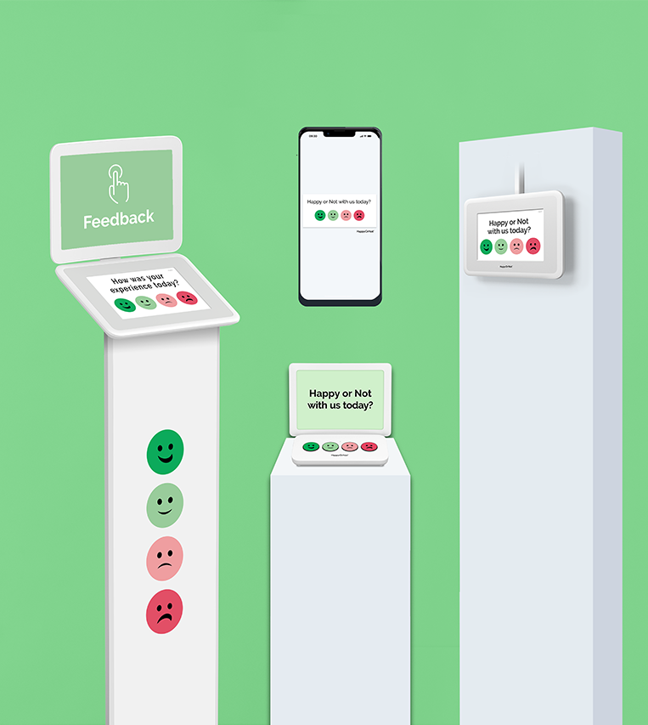
Question Sheet Templates
US size Ledger/Letter

Slide 2
Instructions
Here you can find the standard HappyOrNot question sheet templates we have available for Smiley Terminal Stand, Table and Smiley Touch Stand.
Use short questions to maximize engagement. Small text is hard to read and creates friction
Each question sheet version includes a yellow call-out box with more details about the elements that can be edited
The sheet designs are default US size Ledger. To print Ledger as Letter, set the paper size from the printer settings or inform the print house about the sizing

Slide 3
Margins & guides
Make sure your designs and texts do not go over the noted margins
ONLY FOR HON design area
Text area. REMOVE THIS GUIDELINE
QUESTION SHEET
Size: A3 / A4
Color mode: RGB
Image resolution min. 300 PPI
Save: PowerPoint PDF, PowerPoint file
Background color can be changed
Text area margin line:
do not cross or move
Design area margin line:
do not cross or move
Frame area margin line:
do not cross or move

Slide 4

Feedback
Default version
Feedback text (can be translated)
Background color to brand
Note: adjust the font size depending on the length of the survey question
Feedback finger icon should not be removed

Slide 5
Please rate our service today
Single language version
Survey question
Background color to brand
Font color
Note: adjust the font size depending on the length of the survey question

Slide 6
Please rate our service today
Multiple language version
Survey question in chosen languages
Background color to brand
Font color
Note: adjust the font size depending on the length of the survey question
Miten onnistuimme tänään?

Slide 7
Please rate our service today
Multiple language version
Survey question in chosen languages
Background color to brand
Font color
Note: adjust the font size depending on the length of the survey question
Miten onnistuimme tänään?
Hur lyckades vi idag?

Slide 8

Own logo version
Your company logo
Survey question (optional multi-language)
Background color to brand
Font color
Note: adjust the font size depending on the length of the survey question
HappyOrNot logo cannot be removed
Please rate our service today
Add Your Logo Here

Slide 9

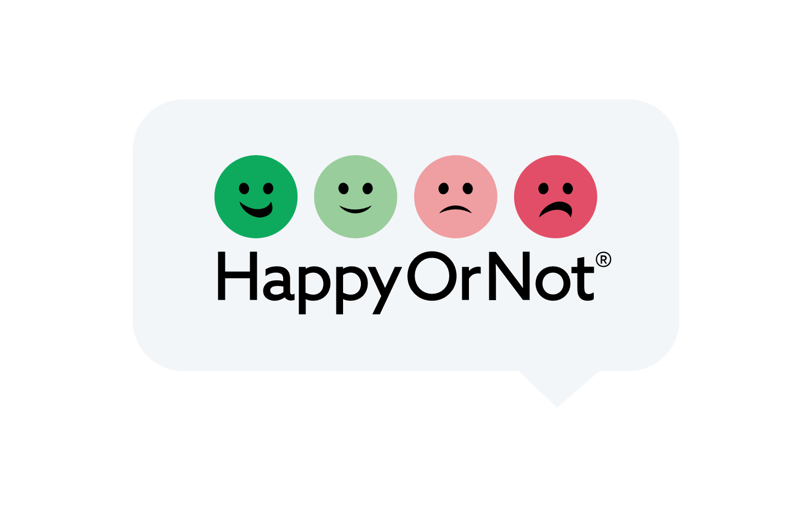
Human version
Survey question (optional multi-language)
Font color
Note: adjust the font size depending on the length of the survey question
HappyOrNot logo cannot be removed
Please rate our service today

Slide 10
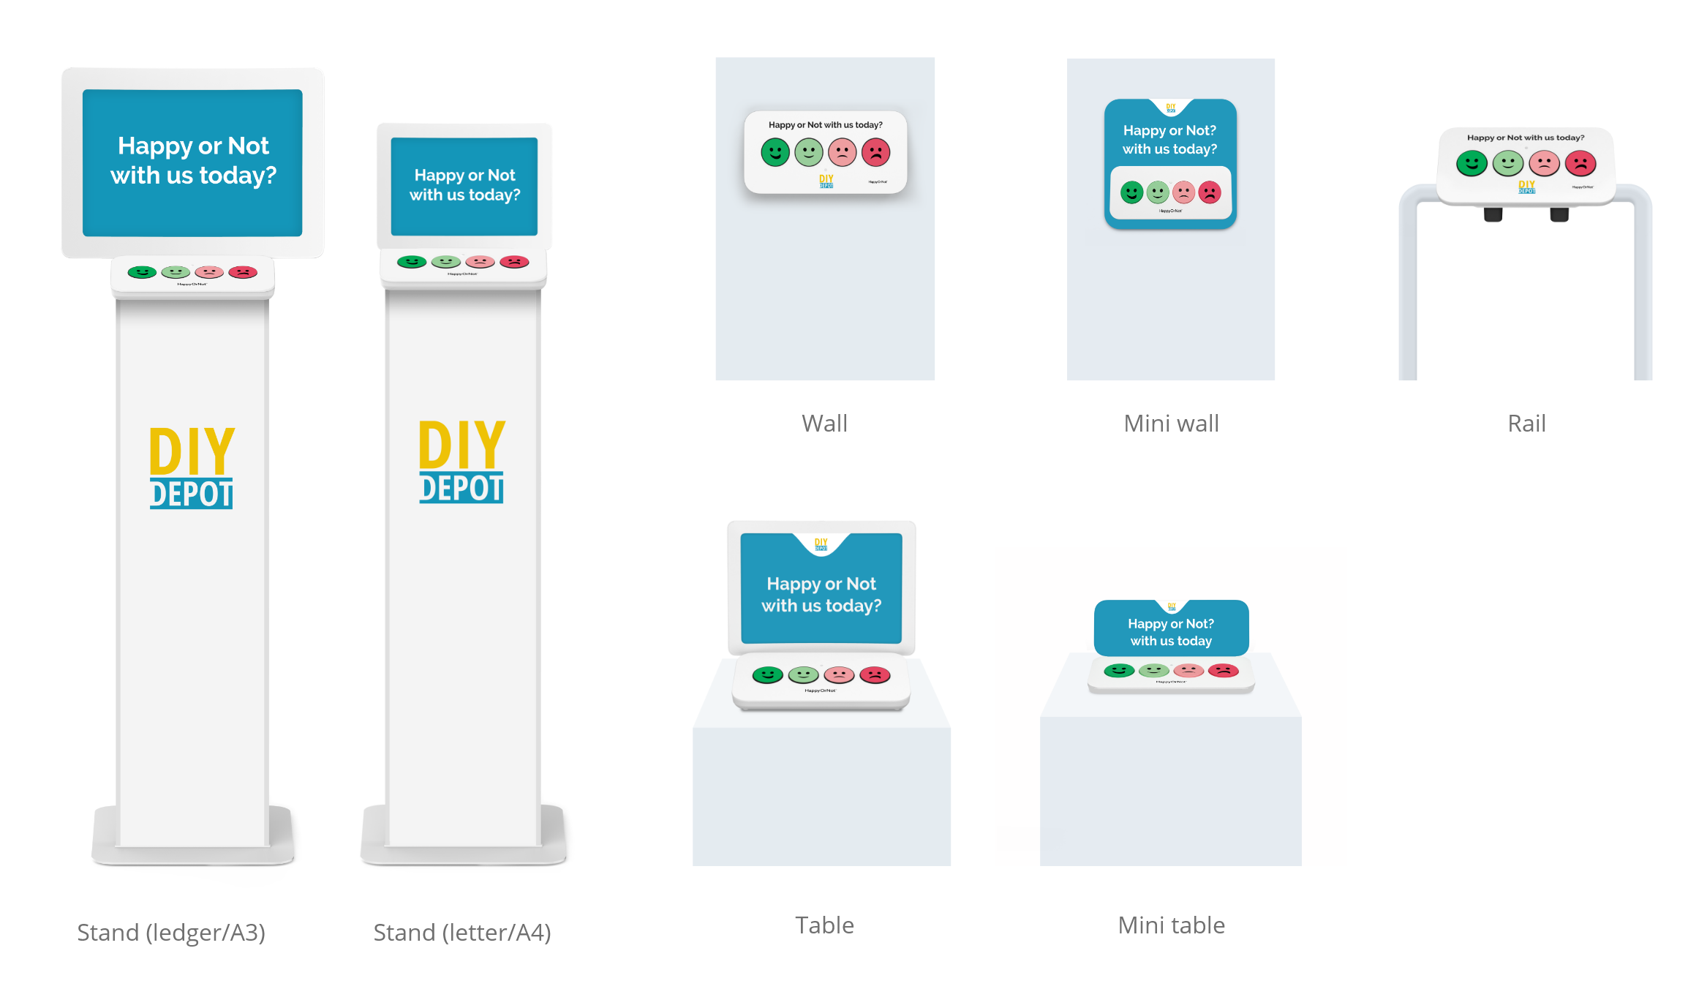
Example mock-ups

Slide 11

Please rate our service today
Miten onnistuimme tänään?

